Slide 1
We have 20 Plicker Cards (IDs 44-63). Pickup Your Own Cards!

Slide 2
Time Allocation of COMP3500
COMP3500
Course Schedule COMP3500 vs. COMP4300
COMP4300
Notes:
Mr. Mao's GTA office hours have been updated:
Monday and Friday: 3:00-4:00 p.m.
Wednesday: 4:30-5:30 p.m.
Location: Shelby 2319. Desk: #17.
Email Address: jzm0122@tigermail.auburn.edu

Slide 3
Tips from Allison Macdonald
“As far as OS161 goes, I would recommend that your students try and find responsible team members and read through the textbook! The last few projects are very hard, and having a good understanding from the book before starting will help to ensure that students are conceptually ready to handle the projects. A lot of times in group projects there is always at least one person who will end up trying to do most of the work alone, but these projects are too big for that, , so I think you should also emphasize how important it is to learn to work as a team in COMP3500.”
Read textbook: conceptually prepare for the projects
Work as a team

Slide 4
https://auburn.service-now.com/it?id=kb_article&sys_id=5bfa6107dbc45b00965cf9b9af961930#arcGIS-content

Slide 5
Excellent in Early Submission Award
Collin Pike

Slide 6
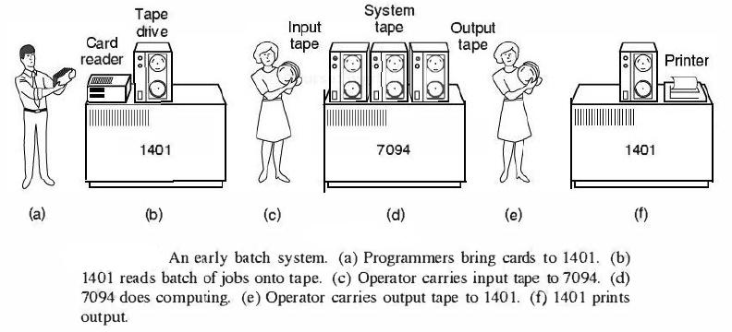
Simple Batch Systems

Slide 7

Exercise 5 (Plickers): Which statement about simple batch systems is correct?
Highly inefficient
Over utilized CPU time
Deliver high throughput
Offer interactivity of users
Hint: A batch system is a dedicated system.
Notes:
Under utilized CPU time
Non-interactivity of users with running jobs

Slide 8
Why multiprogramming rather than Uniprogramming?
When one job needs to wait for I/O, the processor can switch to the other job, which is likely not waiting for I/O
Notes:
This inefficiency is not necessary. We know that there must be enough
memory to hold the OS (resident monitor) and one user program. Suppose that
there is room for the OS and two user programs. When one job needs to wait for
I/O, the processor can switch to the other job, which is likely not waiting for I/O.
Multiprogramming (Batch system) needed for efficiency
Single user cannot keep CPU and I/O devices busy at all times
Multiprogramming organizes jobs (code and data) so CPU always has one to execute
A subset of total jobs in system is kept in memory
One job selected and run via job scheduling
When it has to wait (for I/O for example), OS switches to another job

Slide 9
COMP 3500 Introduction to Operating Systems Operating System Design
Dr. Xiao Qin
Auburn University http://www.eng.auburn.edu/~xqin
xqin@auburn.edu
Notes:
My Story: InfoSys first business trip. Ask an embarrassing question: Why InfoSys application is running on Linux rather than Windows?
Manager replied – Linux is fast.
Lec02b: 42 Minutes Slides 1-18 and 24
Cont. 19-23 to be covered in Lec02c

Slide 10
Purpose of an OS
Coordinate Use
of the Abstractions
Processes
The Abstractions
Create the Abstractions

Slide 11
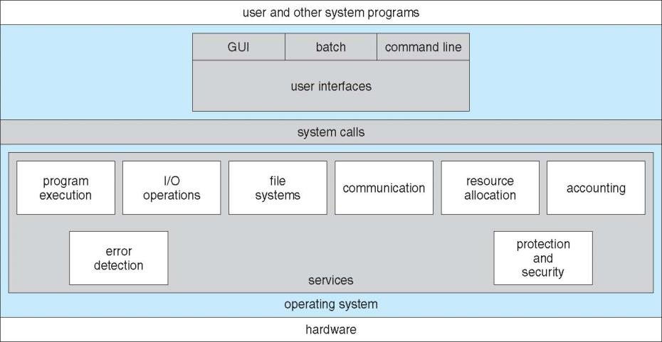
Operating System Services
Exercise 1: Please write down two system services?
Notes:
OS provides an environment for execution of programs and services to programs and users
One set of operating-system services provides functions that are helpful to the user:
User interface - Almost all operating systems have a user interface (UI).
Varies between Command-Line (CLI), Graphics User Interface (GUI), Batch
Program execution - The system must be able to load a program into memory and to run that program, end execution, either normally or abnormally (indicating error)
I/O operations - A running program may require I/O, which may involve a file or an I/O device
One set of operating-system services provides functions that are helpful to the user (Cont.):
File-system manipulation - The file system is of particular interest. Programs need to read and write files and directories, create and delete them, search them, list file Information, permission management.
Communications – Processes may exchange information, on the same computer or between computers over a network
Communications may be via shared memory or through message passing (packets moved by the OS)
Error detection – OS needs to be constantly aware of possible errors
May occur in the CPU and memory hardware, in I/O devices, in user program
For each type of error, OS should take the appropriate action to ensure correct and consistent computing
Debugging facilities can greatly enhance the user’s and programmer’s abilities to efficiently use the system
Another set of OS functions exists for ensuring the efficient operation of the system itself via resource sharing
Resource allocation - When multiple users or multiple jobs running concurrently, resources must be allocated to each of them
Many types of resources - CPU cycles, main memory, file storage, I/O devices.
Accounting - To keep track of which users use how much and what kinds of computer resources
Protection and security - The owners of information stored in a multiuser or networked computer system may want to control use of that information, concurrent processes should not interfere with each other
Protection involves ensuring that all access to system resources is controlled
Security of the system from outsiders requires user authentication, extends to defending external I/O devices from invalid access attempts

Slide 12
Basic Operating System Organization
File
Manager
Process, Thread &
Resource Manager
Memory
Manager
Device
Manager
Processor(s)
Main Memory
Devices
Notes:
Programming interface to the services provided by the OS
Typically written in a high-level language (C or C++)
Mostly accessed by programs via a high-level Application Programming Interface (API) rather than direct system call use
Three most common APIs are Win32 API for Windows, POSIX API for POSIX-based systems (including virtually all versions of UNIX, Linux, and Mac OS X), and Java API for the Java virtual machine (JVM)

Slide 13

Kernel Mode vs. User Mode
Kernel Mode.
Executing code has complete and unrestricted access to the underlying hardware.
Is reserved for the lowest-level, trusted functions of OS.
Crashes in this mode are catastrophic.
User Mode
Executing code has no ability to directly access hardware
Code must delegate to system APIs to access hardware
Crashes in user mode are always recoverable
Notes:
Kernel ModeIn Kernel mode, the executing code has complete and unrestricted access to the underlying hardware. It can execute any CPU instruction and reference any memory address. Kernel mode is generally reserved for the lowest-level, most trusted functions of the operating system. Crashes in kernel mode are catastrophic; they will halt the entire PC.
User ModeIn User mode, the executing code has no ability to directly access hardware or reference memory. Code running in user mode must delegate to system APIs to access hardware or memory. Due to the protection afforded by this sort of isolation, crashes in user mode are always recoverable. Most of the code running on your computer will execute in user mode.

Slide 14
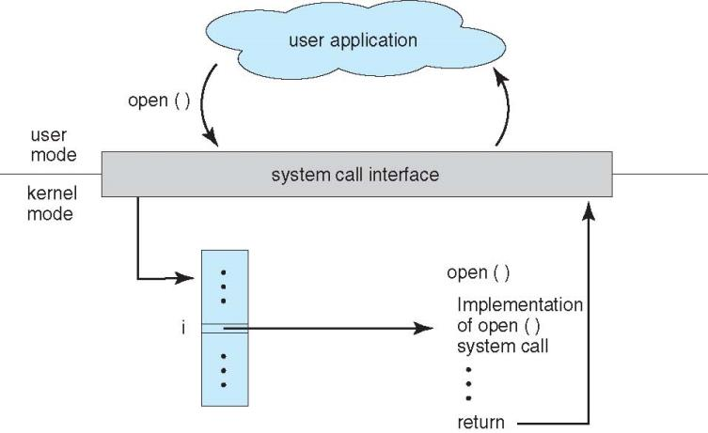
API – System Call – OS Relationship

Slide 15
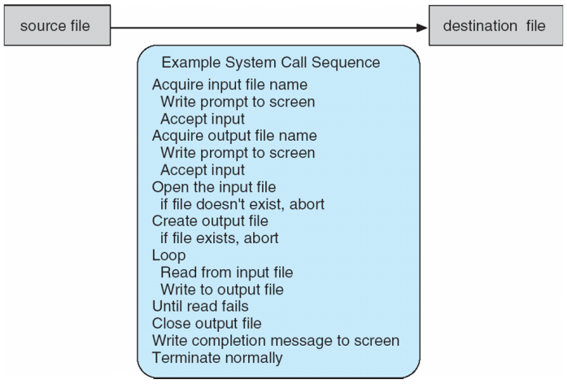

System Calls
System call sequence to copy the contents of one file to another file
Notes:
Programming interface to the services provided by the OS
Typically written in a high-level language (C or C++)
Mostly accessed by programs via a high-level Application Programming Interface (API) rather than direct system call use
Three most common APIs are Win32 API for Windows, POSIX API for POSIX-based systems (including virtually all versions of UNIX, Linux, and Mac OS X), and Java API for the Java virtual machine (JVM)

Slide 16
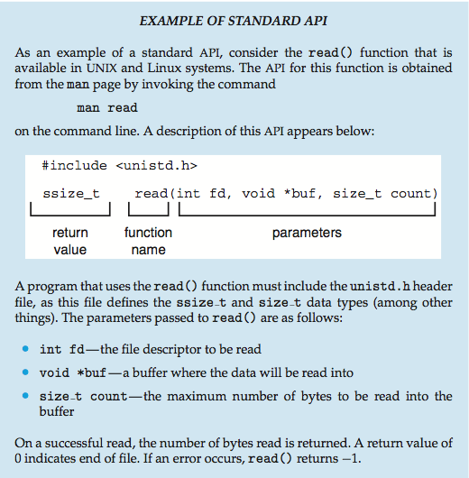
Notes:
System Call Implementation
Typically, a number associated with each system call
System-call interface maintains a table indexed according to these numbers
The system call interface invokes the intended system call in OS kernel and returns status of the system call and any return values
The caller need know nothing about how the system call is implemented
Just needs to obey API and understand what OS will do as a result call
Most details of OS interface hidden from programmer by API
Managed by run-time support library (set of functions built into libraries included with compiler)
System Call Parameter Passing
Often, more information is required than simply identity of desired system call
Exact type and amount of information vary according to OS and call
Three general methods used to pass parameters to the OS
Simplest: pass the parameters in registers
In some cases, may be more parameters than registers
Parameters stored in a block, or table, in memory, and address of block passed as a parameter in a register
This approach taken by Linux and Solaris
Parameters placed, or pushed, onto the stack by the program and popped off the stack by the operating system
Block and stack methods do not limit the number or length of parameters being passed

Slide 17
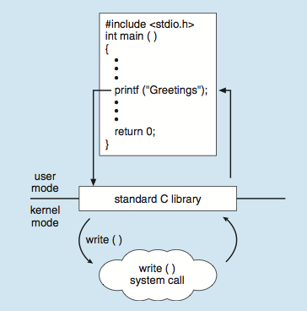

Standard C Library Example
Exercise 2 (Plickers): printf() must call the write() system call for the following reasons except:
printf() uses I/O resources managed by operating systems
printf() relies on an output device managed by device management
printf() depends on a service offered at the user mode
printf() calls a service implemented in the kernel
Notes:
C program invoking printf() library call, which calls write() system call

Slide 18
User Goals vs. System Goals
Which of the following goals are end-user goals?
Which of the following goals are system goals?
Convenient to use
Easy to implement
Easy to learn
Reliable
Easy to maintain
Flexible
Error-free
Efficient and Fast
Safe
Easy to design
Notes:
Design and Implementation of OS not “solvable”, but some approaches have proven successful
Internal structure of different Operating Systems can vary widely
Start the design by defining goals and specifications
Affected by choice of hardware, type of system
Users: use and learn
System: design, implement, and maintain
User goals and System goals
User goals – operating system should be convenient to use, easy to learn, reliable, safe, and fast
System goals – operating system should be easy to design, implement, and maintain, as well as flexible, reliable, error-free, and efficient

Slide 19
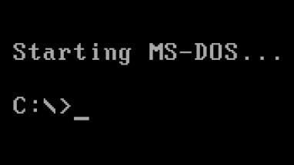
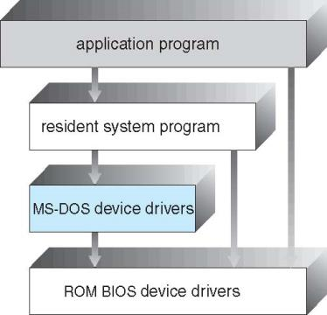
Simple Structure -- MS-DOS
Goal: the most functionality in the least space
Not divided into modules
Interfaces and levels of functionality are not well separated
Notes:
General-purpose OS is very large program
Various ways to structure ones
Simple structure – MS-DOS
More complex -- UNIX
Layered – an abstrcation
Microkernel –Mach
MS-DOS (/ˌɛmɛsˈdɒs/ em-es-doss; acronym for Microsoft Disk Operating System) is an operating system for x86-based personal computers mostly developed byMicrosoft. It was the most commonly used member of the DOS family of operating systems, and was the main operating system for IBM PC compatible personal computers during the 1980s to the mid-1990s, when it was gradually superseded by operating systems offering a graphical user interface (GUI), in various generations of the Microsoft Windows operating system.
MS-DOS resulted from a request in 1981 by IBM for an operating system to use in its IBM PC range of personal computers.^{[7][8]} Microsoft quickly bought the rights to 86-DOS from Seattle Computer Products,^{[9]} and began work on modifying it to meet IBM's specification. IBM licensed and released it in August 1981 as PC DOS1.0 for use in their PCs. Although MS-DOS and PC DOS were initially developed in parallel by Microsoft and IBM, in subsequent years the two products went their separate ways.
During its life, several competing products were released for the x86 platform,^{[10]} and MS-DOS went through eight versions, until development ceased in 2000. Initially MS-DOS was targeted at Intel 8086 processors running on computer hardware using floppy disks to store and access not only the operating system, but application software and user data as well. Progressive version releases delivered support for other mass storage media in ever greater sizes and formats, along with added feature support for newer processors and rapidly evolving computer architectures. Ultimately it was the key product in Microsoft's growth from aprogramming languages company to a diverse software development firm, providing the company with essential revenue and marketing resources. It was also the underlying basic operating system on which early versions of Windows ran as a GUI. It is a flexible operating system, and consumes negligible installation space.

Slide 20
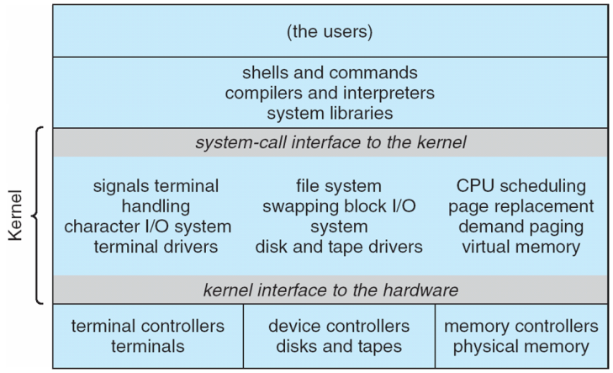
Monolithic Kernel: UNIX System Structure
Notes:
A monolithic kernel is an operating system architecture where the entire operating system is working in kernel space and is alone in supervisor mode. The monolithic model differs from other operating system architectures (such as the microkernel architecture)^{[1][2]} in that it alone defines a high-level virtual interface over computer hardware. A set of primitives or system calls implement all operating system services such as process management, concurrency, and memory management. Device drivers can be added to the kernel as modules.
Non Simple Structure -- UNIX
UNIX – limited by hardware functionality, the original UNIX operating system had limited structuring. The UNIX OS consists of two separable parts
Systems programs
The kernel
Consists of everything below the system-call interface and above the physical hardware
Provides the file system, CPU scheduling, memory management, and other operating-system functions; a large number of functions for one level

Slide 21
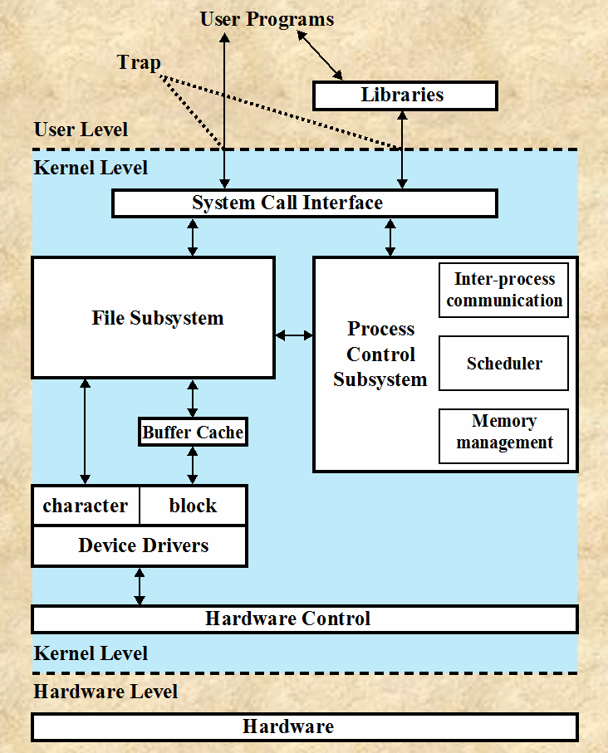
Exercise 3 (Plickers): The monolithic kernel has the following strengths except:
High performance
Easy to port the operating system to new architectures
Low overhead of user space to kernel space communication
Notes:
Benefits:
High performance. Performance overhead of user space to kernel space communication
Detriments:
difficult to port the operating system to new architectures
Reference: http://www.systhread.net/texts/200510kdiff.php
Different Kernel Designs Overview
Kernel terminology gets tossed about quite a bit. One of the more common topics regarding operating system kernels is the overall design. In particular how the kernel is structured. Generally, there are three major types of kernels; monolithic, microkernel and hybrid/modular.
Monolithic
A monolithic kernel is one single program that contains all of the code necessary to perform every kernel related task. Most UNIX and BSD kernels are monolithic by default. Recently more UNIX and BSD systems have been adding the modular capability which is popular in the Linux kernel. The Linux kernel started off monolithic, however, it gravitated towards a modular/hybrid design for several reasons. In the monolithic kernel, some advantages hinge on these points:
Since there is less software involved it is faster.
As it is one single piece of software it should be smaller both in source and compiled forms.
Less code generally means less bugs which can translate to fewer security problems.
Those points are dependent upon how well the software is written in the first place. It can be assumed that a stable kernel that has modular capability added to it will, of course, grow both in raw software terms and regarding internal communications.
Most work in the monolithic kernel is done via system calls. These are interfaces, usually kept in a tabular structure, that access some subsystem within the kernel such as disk operations. Essentially calls are made within programs and a checked copy of the request is passed through the system call. Hence, not far to travel at all.
The disadvantages of the monolithic kernel are converse with the advantages. Modifying and testing monolithic systems takes longer than their microkernel counterparts. When a bug surfaces within the core of the kernel the effects can be far reaching. Also, patching monolithic systems can be more difficult (especially for source patching).
Microkernel
The microkernel architecture is very different from the monolithic. In the microkernel, only the most fundamental of tasks are are performed such as being able to access some (not necessarily all) of the hardware, manage memory and coordinate message passing between the processes. Some systems that use microkernels are QNX and the HURD. In the case of QNX and HURD, user sessions can be entire snapshots of the system itself or views as it is referred to. The very essence of the microkernel architecture illustrates some of its advantages:
Maintenance is generally easier. Patches can be tested in a separate instance, then swapped in to take over a production instance.
Rapid development time, new software can be tested without having to reboot the kernel.
More persistence in general, if one instance goes hay-wire, it is often possible to substitute it with an operational mirror.
Again, all of the points are making certain assumptions about the code itself. Assuming the code is well formed, those points should stand reasonably well.
Most microkernels use a message passing system of some sort to handle requests from one server to another. The message passing system generally operates on a port basis with the microkernel. As an example, if a request for more memory is sent, a port is opened with the microkernel and the request sent through. Once within the microkernel, the steps are similar to system calls.
Disadvantages in the microkernel exist however. A few examples are:
Larger running memory footprint
More software for interfacing is required, there is a potential for performance loss (note, the QNX system is extraordinarily fast).
Messaging bugs can be harder to fix due to the longer trip they have to take versus the one off copy in a monolithic kernel.
Process management in general can be very complicated.
The disadvantages for microkernels are extremely context based. As an example, they work well for small single purpose (and critical) systems because if not many processes need to run, then the complications of process management are effectively mitigated.
Modular/Hybrid Kernels
Many traditionally monolithic kernels are now at least adding (if not actively exploiting) the module capability. The most well known of these kernels is the Linux kernel. The modular kernel essentially can have parts of it that are built into the core kernel binary or binaries that load into memory on demand. It is important to note that a code tainted module has the potential to destabilize a running kernel. Many people become confused on this point when discussing microkernels. It is possible to write a driver for a microkernel in a completely separate memory space and test it before going live. When a kernel module is loaded, it accesses the monolithic portion's memory space by adding to it what it needs, therefore, opening the doorway to possible pollution. A few advantages to the modular kernel are:
Faster development time for drivers that can operate from within modules. No reboot required for testing (provided the kernel is not destabilized).
On demand capability versus spending time recompiling a whole kernel for things like new drivers or subsystems.
Faster integration of third party technology (related to development but pertinent unto itself nonetheless).
Modules, generally, communicate with the kernel using a module interface of some sort. The interface is generalized (although particular to a given operating system) so it is not always possible to use modules. Often the device drivers may need more flexibility than the module interface affords. Essentially, it is two system calls and often the safety checks that only have to be done once in the monolithic kernel now may be done twice.
Some of the disadvantages of the modular approach are:
With more interfaces to pass through, the possibility of increased bugs exists (which implies more security holes).
Maintaining modules can be confusing for some administrators when dealing with problems like symbol differences.
Summary
A great deal of the advantages and disadvantages of any given design are very much dependent upon the context of the system itself. To generalize and say the monolithic kernel is always faster than it's micro or modular counterpart is somewhat of a misnomer. There are many ways to illustrate it, one good way however is to look at tuning factors.
A microkernel that is designed for a specific platform or device is only ever going to have what it needs to operate. A monolithic kernel, while initially loaded with subsystems that may not be needed can be tuned to a point where it is as fast or faster than the one that was specifically designed for the hardware, although more in a general sense.
Another context to keep in mind is the purpose. Not all servers are general, even though they can be. A small web server for example does not necessarily need massive in machine redundancy. If it is small, it should be easy to duplicate on another system or even just restore quickly from backups. A database of medical records, however, is a completely different matter. If the product itself does not have clustering and failover capability or you cannot afford it, using a modular or microkernel servers based system might be a better option.
In summary, there are lots of different kernel types and lots of different situations in which they can be employed. Hopefully the article has shed some light onto the types and a few of the arguments therein.

Slide 22
Microkernel System Structure
Exercise 4 (2-Min Group Discussion) : What are the pros and cons of this structure?
Notes:
In computer science, a microkernel (also known as μ-kernel) is the near-minimum amount of software that can provide the mechanisms needed to implement an operating system (OS). These mechanisms include low-level address space management,thread management, and inter-process communication (IPC).
Moves as much from the kernel into user space
Mach example of microkernel
Mac OS X kernel (Darwin) partly based on Mach
Communication takes place between user modules using message passing
Benefits:
Easier to extend a microkernel
Easier to port the operating system to new architectures
More reliable (less code is running in kernel mode)
More secure
Detriments:
Performance overhead of user space to kernel space communication

Slide 23
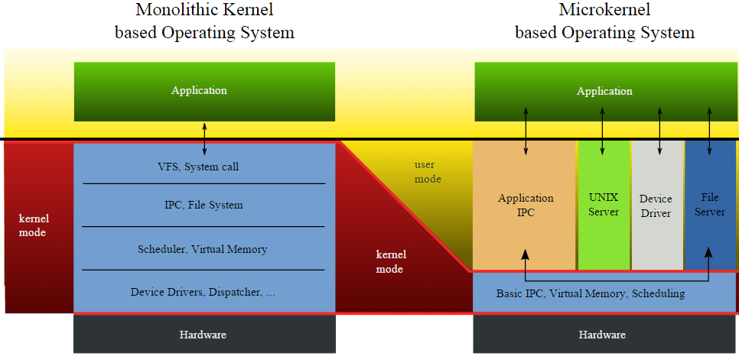
Monolithic Kernel vs. Microkernel
Exercise 5: Which structure should we use to build an OS for embedded systems (e.g., real-time robotic systems)?

Slide 24
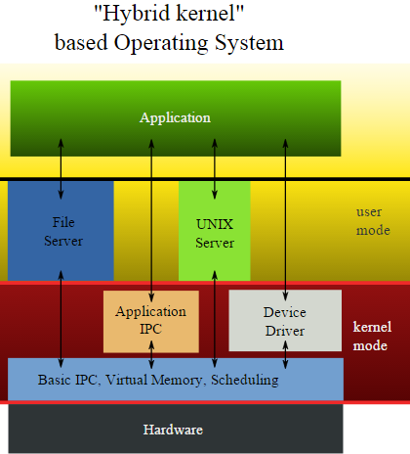



Hybrid Systems
Notes:
Most modern operating systems are actually not one pure model
Hybrid combines multiple approaches to address performance, security, usability needs
Linux and Solaris kernels in kernel address space, so monolithic, plus modular for dynamic loading of functionality
Windows mostly monolithic, plus microkernel for different subsystem personalities
Apple Mac OS X hybrid, layered, Aqua UI plus Cocoa programming environment
Below is kernel consisting of Mach microkernel and BSD Unix parts, plus I/O kit and dynamically loadable modules (called kernel extensions)

Slide 25
Mac OS X Structure

Slide 26
iOS
Structured on Mac OS X, added functionality
Does not run OS X applications natively
Also runs on different CPU architecture (ARM vs. Intel)
Cocoa Touch Objective-C API for developing apps
Media services layer for graphics, audio, video
Core services provides cloud computing, databases
Core operating system, based on Mac OS X kernel
Notes:
Apple mobile OS for iPhone, iPad

Slide 27
Android Architecture
Notes:
Developed by Open Handset Alliance (mostly Google)
Open Source
Similar stack to IOS
Based on Linux kernel but modified
Provides process, memory, device-driver management
Adds power management
Runtime environment includes core set of libraries and Dalvik virtual machine
Apps developed in Java plus Android API
Java class files compiled to Java bytecode then translated to executable than runs in Dalvik VM
Libraries include frameworks for web browser (webkit), database (SQLite), multimedia, smaller libc

Slide 28
Summary
OS Services
Basic Operating System Organization
Kernel Mode vs. User Mode
Monolithic Kernel
Microkernel

Slide 29
Reading Assignment
Chapter 1.4 Operating System Structure
Chapter 1.5 Operating System Operations

